Slide 1
Ebook reading and response essay
Term project

Slide 2
Ebook
Title: my country and my people
Author: Lin, Yutang
English PDF: from 2nd class (202.117.216.244) or iLearning (https://xjtu.ilearningpro.unipus.cn, unipus account to login)
Chinese version: available on ‘weChat Reading’ app – use it for your needs

Slide 3
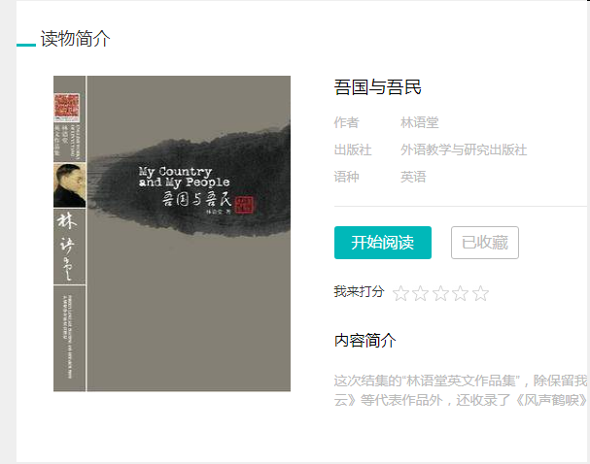
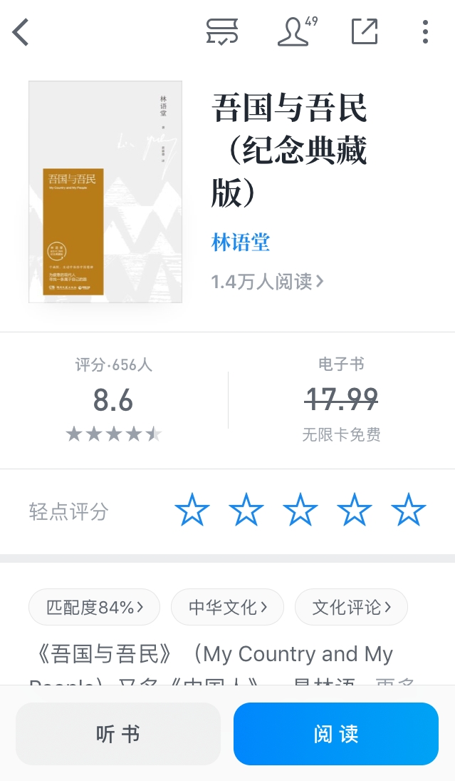
Chinese version EBOOK

Slide 4
Term project 2 parts
Part 1: READ required chapters
  Finish reading assigned parts weekly (from wk3)
  Take your own notes while reading (can be keywords, summary of this part by your own, English vocabulary you don’t know, your point of view for this chapter); save this note; you will need it for writing essay later
  GRADE: Upload your notes on SY board each week by schedule (attch a file, eg. Word doc., picture, voice record etc.)
Part 2: WRITE a response essay based on your reading - wait for my instruction

Slide 5
Reading task - chapter breakdown
Chapter Two The Chinese Character YOU MUST READ
Wk 3 I. Mellowness91-4
Wk 4 II. Patience95-2
Wk 4 III. Indifference97-4
Wk 5 IV. Old Roguery100-5
Wk 6 V. Pacifism106-4
Wk 7 VI. Contentment109-4.5
Wk 8 VII. Humor 114-5.5
Wk 9 VIII. Conservatism 120-4
Chapter Eight The Artistic Life OPTIONAL READING
I. The Artist334-3.5
II. Chinese Calligraphy337-7.5
III. Painting344-14
IV. Architecture359-10
Chapter Nine The Art of Living OPTIONAL READING
I. The Pleasures of Life 370-7.5
II. House and Garden377-7
III. Eating and Drinking 384-9

Slide 6
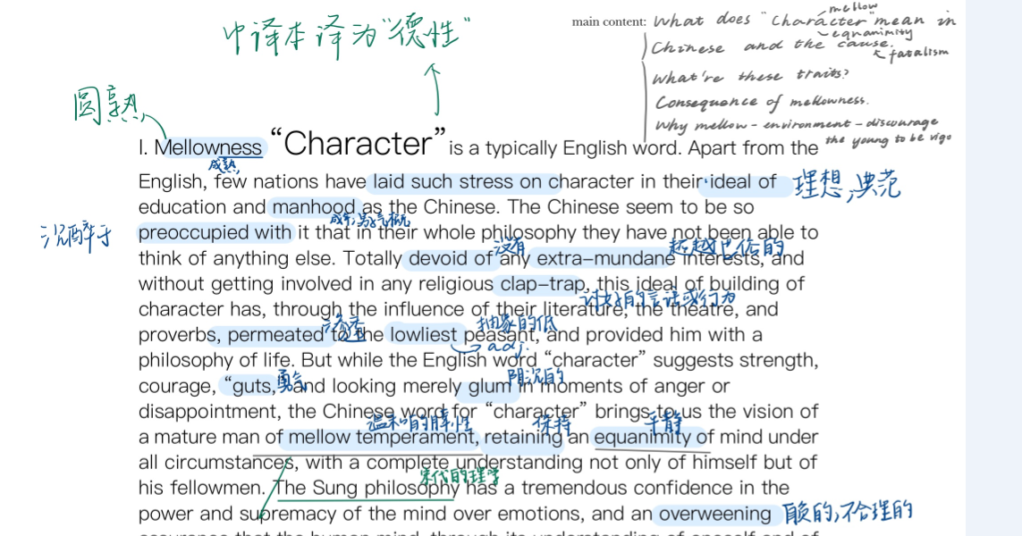
Sample notes looking

Slide 7
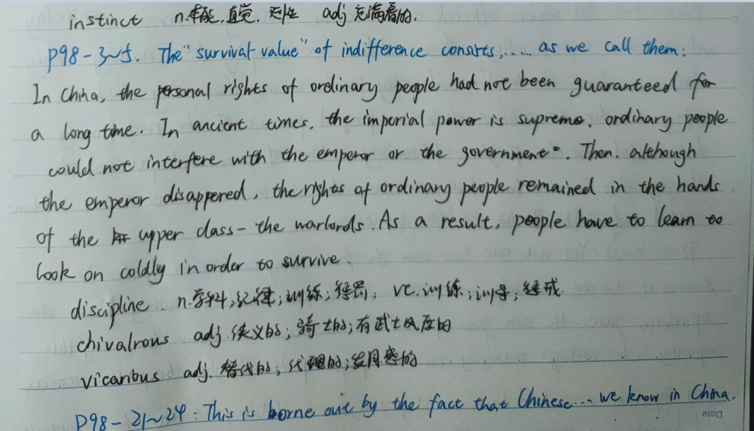
Sample notes looking

Slide 8
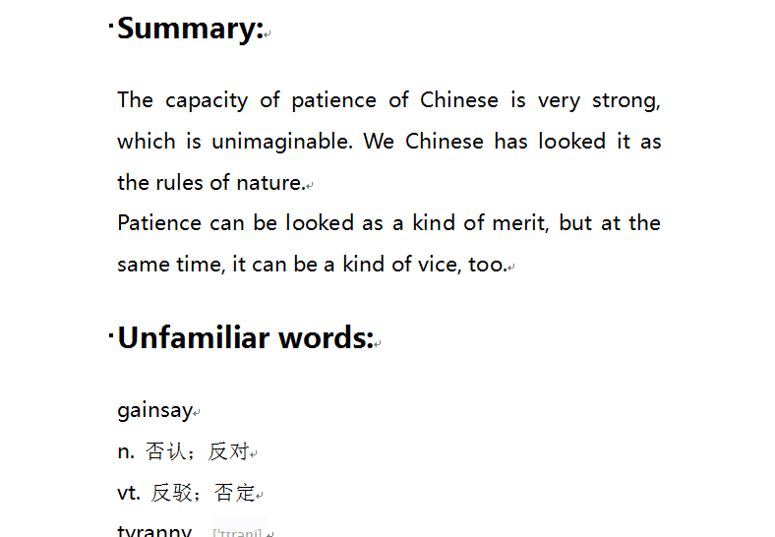
Sample notes looking

